Slide 1
Existing Data Sources and Users

Slide 2
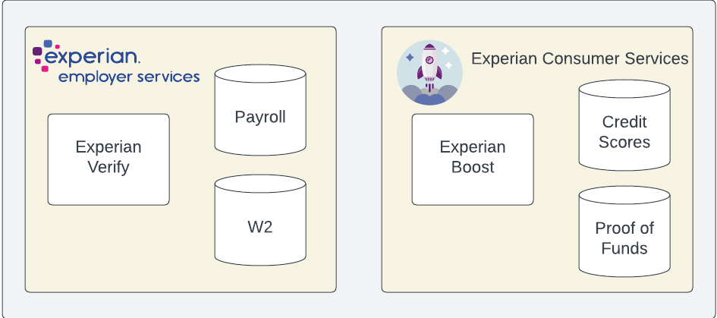
Existing Data Sources and Users

Slide 3

Existing Data Sources and Users
Mortgage Lenders

Slide 4

Existing Data Sources and Users
Home Buyers
Mortgage Lenders

Slide 5
Mortgage Originations
$2.25T

Slide 6
Mortgage Originations
$2.25T

Slide 7
Mortgage Originations
$2.25T
$2.25T

Slide 8
Mortgage Originations
$2.25T
$2.25T
Median Home Price:
^{$390,000}

Slide 9
Mortgage Originations
$2.25T
$2.25T
Median Home Price:
^{$390,000}

Slide 10
Market Opportunity
Experian Employer Services combined records cover 11.2% of the US Workforce.

Slide 11
Market Opportunity
Experian Employer Services combined records cover 11.2% of the US Workforce.
Total Market (new originations):
^{5.76M}

Slide 12
Market Opportunity
Experian Employer Services combined records cover 11.2% of the US Workforce.
Total Market:
^{5.76M}

Slide 13
Market Opportunity
Experian Employer Services combined records cover 11.2% of the US Workforce.
EES Total Record Coverage:
Total Market:
^{5.76M}
^{643,574}

